Slide 1
Pitching FinOps to your Org
These slides are intended to provide an executive-level overview of the challenges of running on cloud and how FinOps can help optimize cost and usage
The primary use case is anyone who wants to introduce FinOps into their organization
Throughout the deck, there are dash-border comment boxes which recommend areas where you may want to include data or information from your own organization. Use as you see fit
Tailor any of the slides to your needs. Add/ remove slides and content, add real anecdotes and other information relevant to your own use case
Remove this slide before final draft

Slide 2
FinOps at our Organization
Introducing FinOps to key decision makers

Slide 3
The Current State of Cloud

Slide 4
The Rise of the Cloud Economy
Cloud spending has reached a tipping point
Public Cloud Spend
$360B
Spend in the cloud is growing exponentially, and companies are struggling to contain OPEX costs.
by 2022
$141B
Pre- 2000’s
2000’s
2006
Now
Datacenter Centric IT
Born in the Web Companies
EC2 Launched, Rise of Agile, Lean,& Devops
Cloud Centric IT
Fixed Cost
CapEx Weighted Spend
Variable Cost
OpEx Weighted Spend
Notes:
Source:
https://www.informationweek.com/cloud/infrastructure-as-a-service/idc-public-cloud-spending-to-double-by-2019/d/d-id/1324014

Slide 5
A Real World Example
Use this example, or replace with information of your own organization’s struggle with containing cloud spend
£4.29m spent over 18 months
£1.42m over budget (33%)
£2.2m wasted spend (51%)
Notes:
To put this into context, here’s a very recent example.
This organisation accelerated their cloud usage at the start of 2018. Since that point they have spent around £4.3m. As you can see their usage pattern has followed a relatively normal trend (i.e. it’s gone up by a lot). They’ve had several spikes over the period, the first one you can see was causes by an expected annual trend where they needed short term resources. If you look at the dates, you can probably work out the sector in which they operate.
The second spike was driven by several new services, plus the introduction of a greater level of availability for their critical applications and services. Overall their trend was constantly upwards, going from £60K a month in Jan 2018 to £450K by July 2019.
It’s important to mention that this isn’t necessarily bad, many cloud customers totally expect this level of spend and growth as they migrate into the cloud from their on-premise datacentres.
They had an internal budget process and had attempted to forecast their projected spend. As you can see, it didn’t go as well as they planned. Over the period they overspent their budget by £1.42m – a 33% hit.
A spend review was instigated and the outcome wasn’t great. What it showed was that over the period a large proportion of their overall spend was not required. It showed that over 50% of their total spend could have been avoided, meaning a total overspend of £2.2m.
As you can clearly see from the chart, if they’d had controls in place, they would have been significantly below their forecasted spend.

Slide 6
The Source of the Issue
Use this example, or replace with information of your own organization’s struggle with containing cloud spend
1
The wrong resources
6
Storage & data protection
2
Unused & Inactive
7
Connectivity & bandwidth
3
Over-sizing
8
Analytics
4
Development Approach
9
Lack of Automation
5
Purchase Approach
10
Decision-making
Notes:
Poor cloud financial management impacts our innovation and our bottom line:
Increases cost, degrading profitability
Cripples innovation
Delays other critical projects
Causes organizational conflict
Slows or halts cloud adoption
Degrades customer experience

Slide 7
What is FinOps?

Slide 8



FinOps…
… is the practice of bringing together Finance, Technology, and Business to master the unit economics of the cloud for business advantage
The financial operating model for the cloud
A way of introducing accountability for cloud spend
A cultural practice that delivers financial and operational control

Slide 9
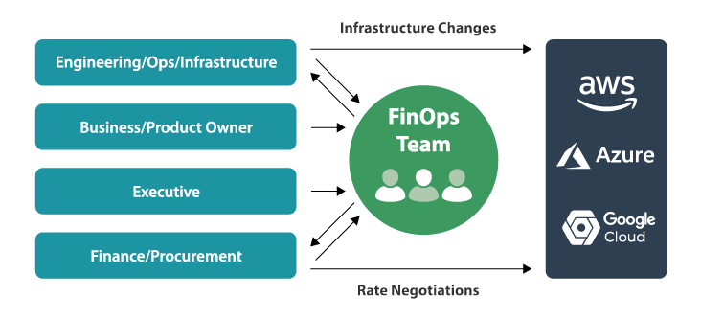
The FinOps Operating Model
In the way that DevOps revolutionized end-to-end product delivery, FinOps is changing how to manage Cloud OpEx

Slide 10
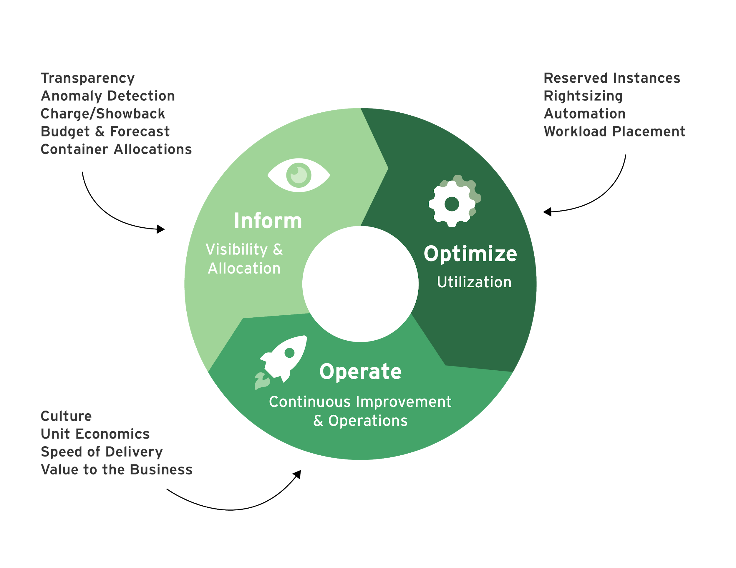
FinOps Lifecycle

Slide 11



Key Functions of Each Phase
Iterative phases establish baselines, optimize rates and usage patterns and drive operations to the right balance of cost efficiency and business value.
Inform
Dashboards & Reporting
Direct Chargeback
Anomaly Alerts
Budgets & Forecasting
Optimize
Terminate Idle Resources
Schedule server run times
Right size Resources based on utilization
Use serverless technologies
Operate
Continuous Improvement
Align with Finance and Line of Business
Evaluate the value to the business
Notes:
Inform to understand costs, set benchmarks and establish budgets & tracking
Optimize to right-size under/over-utilized resources, set an RI buying process and obtain best pricing
Operate in which finance and IT move together, to continuously improve for efficiency & innovation

Slide 12
FinOps Success at [your org]

Slide 13

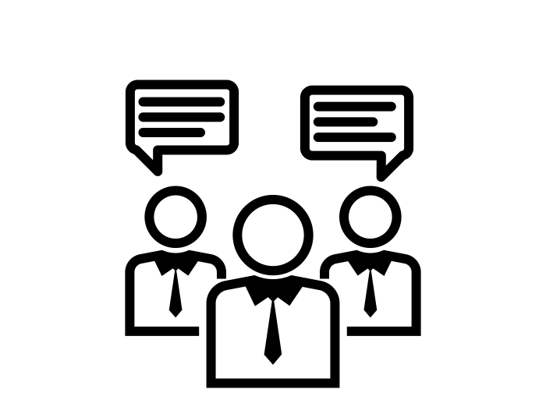




This is What Success Looks Like
Cross organisational trust and goodwill
Breaking down of departmental silos
Accountability and auditability
Reduction in cloud waste = lower costs
Acceleration in innovation
Fewer panic attacks when cloud bills arrive
Notes:
Successful anecdotes from a Fortune 100 financial services company who implemented FinOps
In less than a year, over 15% of the 5,000 person IT organization is utilizing tooling to get daily updates on the costs and utilization of their cloud environment
Product/application teams are using the FinOps best practices to manage their cloud consumption
Financial accountability is being built into the architecture and operations of product/application teams

Slide 14
Next Steps
In order to see if FinOps is right for this organization (surprise, it is!):
Establish virtual teams and processes to instantiate the 3-phase approach
Review cloud bill to establish level of potential savings
Begin a pilot of a few apps or product delivery teams to evaluate and execute FinOps Principles

